Slide 1
Cloud Pak for Data Introduction —

Slide 2

Contents
Projects vs Products 3
OpenShift Overview 5
OpenShift Features 7
IBM Cloud Paks 15

Slide 3
Cloud Pak for Data uses some thing with the best of IBM Data/AI and open source tools

Slide 4
Projects vs. Products
Production-Grade Open Source Project
quarterly minor releases, no Long Term Support
community support
platform certification: (AKS, EKS, GKE, IKS)
core framework / limited security
platform or user responsible to integrate beyond core
Production-Grade Open Source based Product
quarterly releases, support for major release 3+ years
enterprise support
ecosystem certification: platform and app containers
k8s core plus abstractions / dashboard / security
opinions and integration of common features

Slide 5
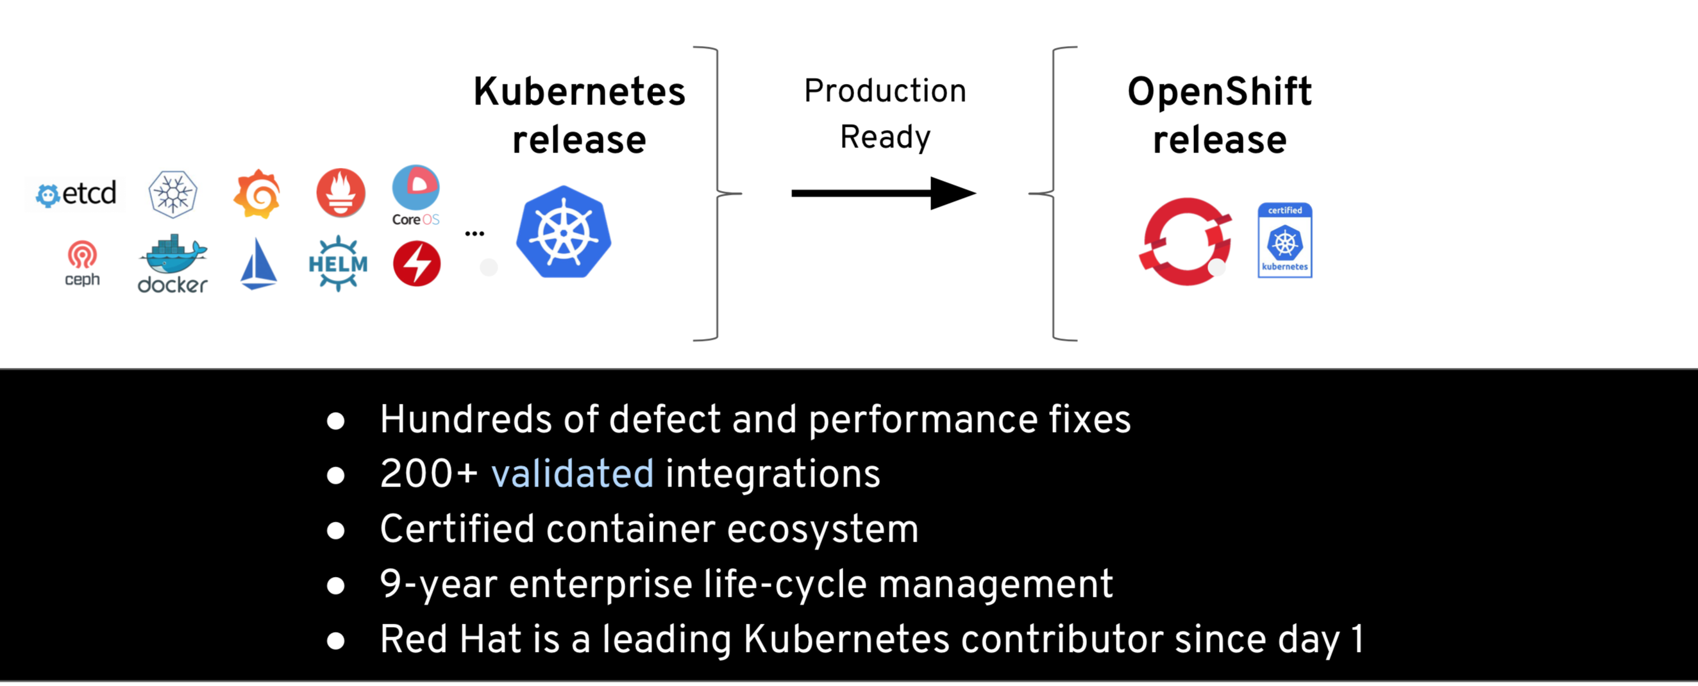
OpenShift is trusted enterprise Kubernetes

Slide 6
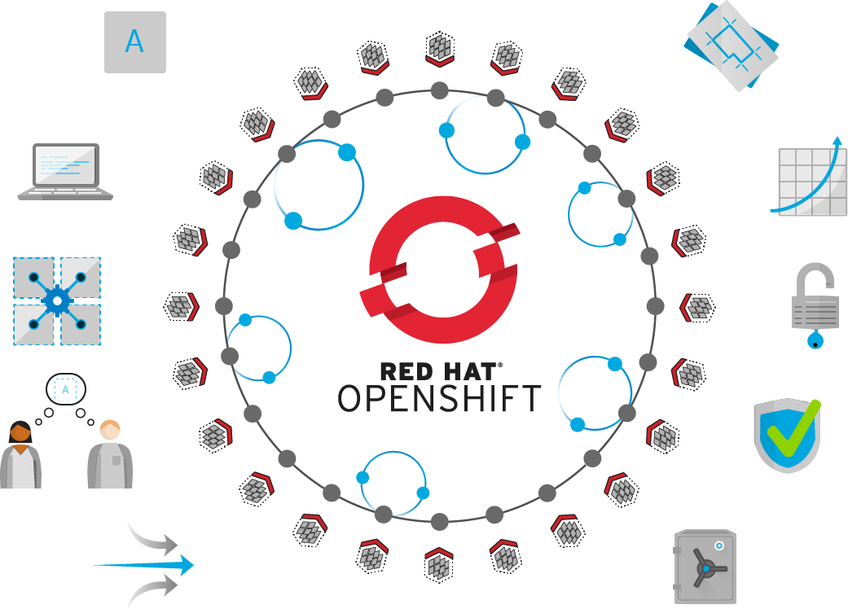
Self-Service
Standards-based
Multi-language
Web-scale
Automation
Open Source
Collaboration
Enterprise Grade
Multi-tenant
Secure
Notes:
Red Hat helps organizations develop, deploy, and manage existing and container-based applications seamlessly across physical, virtual, and public cloud infrastructures.
Built on proven open source technologies, OpenShift helps application development and IT operations teams modernize applications, deliver new services, and accelerate development processes.
OpenShift Container Platform provides developers with an optimal platform for provisioning, building, and deploying applications and their components in a self-service fashion. With automated workflows like our source-to-image (S2I) process, it is easy to get source code from version control systems into ready-to-run, docker-formatted container images.
OpenShift IT operations a secure, enterprise-grade Kubernetes that provides policy-based control and automation for applications. Cluster services, scheduling, and orchestration provide load-balancing and auto-scaling capabilities. Security features prevent tenants from compromising other applications or the underlying host. And because OpenShift can attach persistent storage directly to containers, IT organizations can run both stateful and stateless applications on one platform.

Slide 7
OpenShift Container Platform
Application Services
Cluster Services
Developer Services
Middleware, Service Mesh, Functions, ISV
Metrics, Chargeback, Registry, Logging
Dev Tools, Automated Builds, CI/CD, IDE
Automated Operations*
Kubernetes
Red Hat Enterprise Linux or Red Hat CoreOS
Best IT Ops Experience
CaaS
PaaS
Best Developer Experience
*coming soon
Notes:
Running containers and Kubernetes in production takes more than just a hardened distribution of Kubernetes. It also requires:
A secure, enterprise-grade Linux container host. Red Hat Enterprise Linux is the most trusted Linux OS in the Fortune 500, while Red Hat CoreOS is an immutable, minimal OS with a tiny, tiny attack surface. Depending on your needs, both offer a scalable, trusted base for your container stack.
Once you have Kubernetes, you also need to manage everything that hooks into it. Kubernetes provides Container Networking and Storage Interfaces (CNI, CSI), but OpenShift comes with networking and (for an add-on), an integrated storage solution, along with support for validated networking and storage plugins. Openshift also provides lifecycle management for these components, consoles for operators and developers, and considers security throughout the entire lifecycle. And with CoreOS, we’re bringing in automated operations, updating these components can happen in the background, while your team focuses on other tasks.
Validated integrations: https://access.redhat.com/articles/2176281
OpenShift offers Cluster Services that are essential to enterprise operation: a private container registry, built-in logging and metrics, and metering and chargeback capabilities so you can manage multiple teams.
For a Container-as-a-service experience, the OpenShift Service Catalog and Kubernetes operators allow teams to easily provision and consume a variety of services, whether they’re private to your organization, from a public cloud like AWS, or an ISV like MongoDB. And with the forthcoming addition of operators, these can make real-time decisions automatically for your application and cluster as well.
For a more Platform-as-a-service experience, OpenShift also wraps in a rich developer experience. Our Source-to-image (S2I) capability automatically builds container images based on the changes to application logic your developers commit, while Image Streams can perform a new action (including deployment) once a new version of a container is created.
Altogether, Openshift is a complete platform for building, deploying, and intelligently managing Kubernetes applications in production.

Slide 8


















OpenShift Architecture
ROUTING LAYER
SERVICE LAYER
RED HAT
ENTERPRISE LINUX
NODE
NODE
NODE
PERSISTENT
STORAGE
SCM
(GIT)
MASTER
C
C
API/AUTHENTICATION
c
CI/CD
C
C
C
DATA STORE
RHEL
RHEL
RHEL
SCHEDULER
NODE
NODE
NODE
REGISTRY
EXISTING AUTOMATION TOOLSETS
HEALTH/SCALING
C
C
C
C
C
RHEL
RHEL
RHEL
PHYSICAL
VIRTUAL
PRIVATE
PUBLIC
HYBRID
Notes:
Speaker:
* This is a high level architecture diagram of the OpenShift 3 platform. On the subsequent slides we will dive down and investigate how these components interact within an OpenShift infrastructure.
Discussion:
* Set the stage for describing the OpenShift architecture.
Transcript:
OpenShift has a complex multi-component architecture. This presentation is usable to help prospects understand how the components work together.

Slide 9

Container runtime
A lightweight, OCI-compliant container runtime
Minimal and Secure Architecture
Optimized for Kubernetes
Runs any OCI-compliant image (including docker)
Notes:
Kubernetes introduced Container Runtime Interface (CRI), a plugin interface that gives Kubernetes the ability to use different OCI-compliant container runtimes. Building on that work, the CRI-O provides a lightweight runtime for Kubernetes. Prior to the introduction of CRI, Kubernetes was tied to specific container runtimes while with CRI, Kubernetes can be container runtime-agnostic.
CRI-O currently supports the runc and Clear Container runtimes which are the more mature OCI-complaint runtimes
CRI-O is developed by maintainers and contributors from Red Hat, Intel, IBM, Suse, Hyper and others

Slide 10
Routes
routes add services to the external load-balancer and provide readable urls for the app
ROUTE app-prod.mycompany.com
> curl http://app-prod.mycompany.com
BACKEND SERVICE
POD
POD
POD
CONTAINER
CONTAINER
CONTAINER
Notes:
A router uses the service selector to find the service and the endpoints backing the service. When both router and service provide load balancing, OpenShift Container Platform uses the router load balancing. A router detects relevant changes in the IP addresses of its services and adapts its configuration accordingly
A built-in router comes with OpenShift however it can be replaced by external load-balancers like F5

Slide 11

Projects – extends k8s namespaces
projects isolate apps across environments, teams, groups and departments
PAYMENT DEV
CATALOG
POD
POD
POD
❌
POD
POD
POD
C
C
C
C
C
C
PAYMENT PROD
INVENTORY
POD
POD
POD
❌
❌
POD
POD
POD
C
C
C
C
C
C
Notes:
A user can only access projects that they have created or explicitly given access to

Slide 12







Source-to-Image
COMMIT APP
(User)
code
Git Repository
Developer
BUILD IMAGE
(OpenShift)
Source-to-Image (S2I)
Builder Image
Image Registry
DEPLOY
(OpenShift)
Application Container
deploy
User/Tool Does
OpenShift Does
Notes:
Blue: OpenShift does Green: User does
Developers write code using existing development tools such as Maven, NPM, Bower, PIP, Dockerfile and Git and then access the OpenShift Web, CLI or IDE to create an app from the code
S2I combines source code with a builder image (language and application runtimes) and stores the resulting application image in the image registry
This image registry by default is the OpenShift integrated docker registry however users can configure S2I to push the built images to third-party registries such as Docker Hub, Nexus, Artifactory, Amazon ECR, Quay, etc.
OpenShift monitors the builder images in the image registry and can automatically rebuild the application images if the language (e.g. Java, Ruby, etc) or application runtime (JBoss EAP, JBoss Web Server, Tomcat, etc) image is updated for example due to security patches.
OpenShift automates the deployment of application containers across multiple hosts via the Kubernetes. Users can trigger deployments, rollback, configure A/B or other custom deployments

Slide 13

Jenkins-as-a-Service
Certified Jenkins images with pre-configured plugins
Provided out-of-the-box
Follows Jenkins 1.x and 2.x LTS versions
Jenkins S2I Builder for customizing the image
Install Plugins
Configure Jenkins
Configure Build Jobs
OpenShift plugins to integrate authentication with OpenShift and also CI/CD pipelines
Dynamically deploys Jenkins slave containers
Plugins Jobs
Configuration
Jenkins (S2I)
Jenkins Image
Custom Jenkins Image

Slide 14
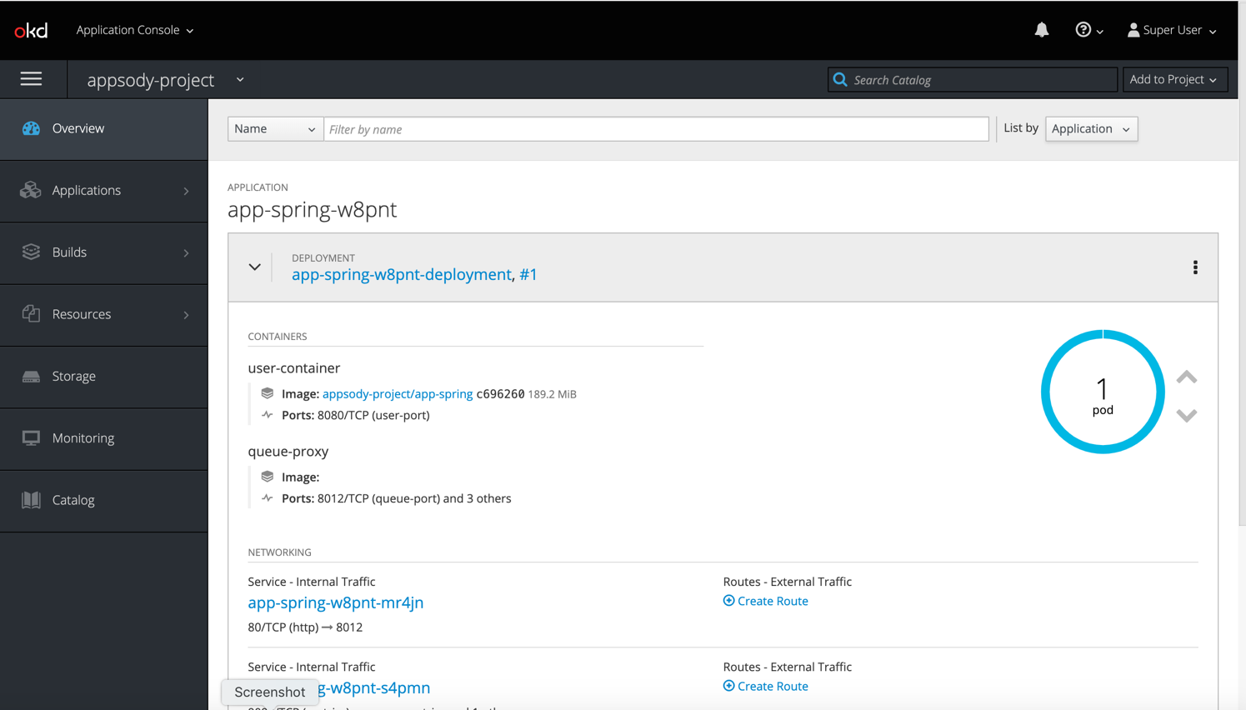
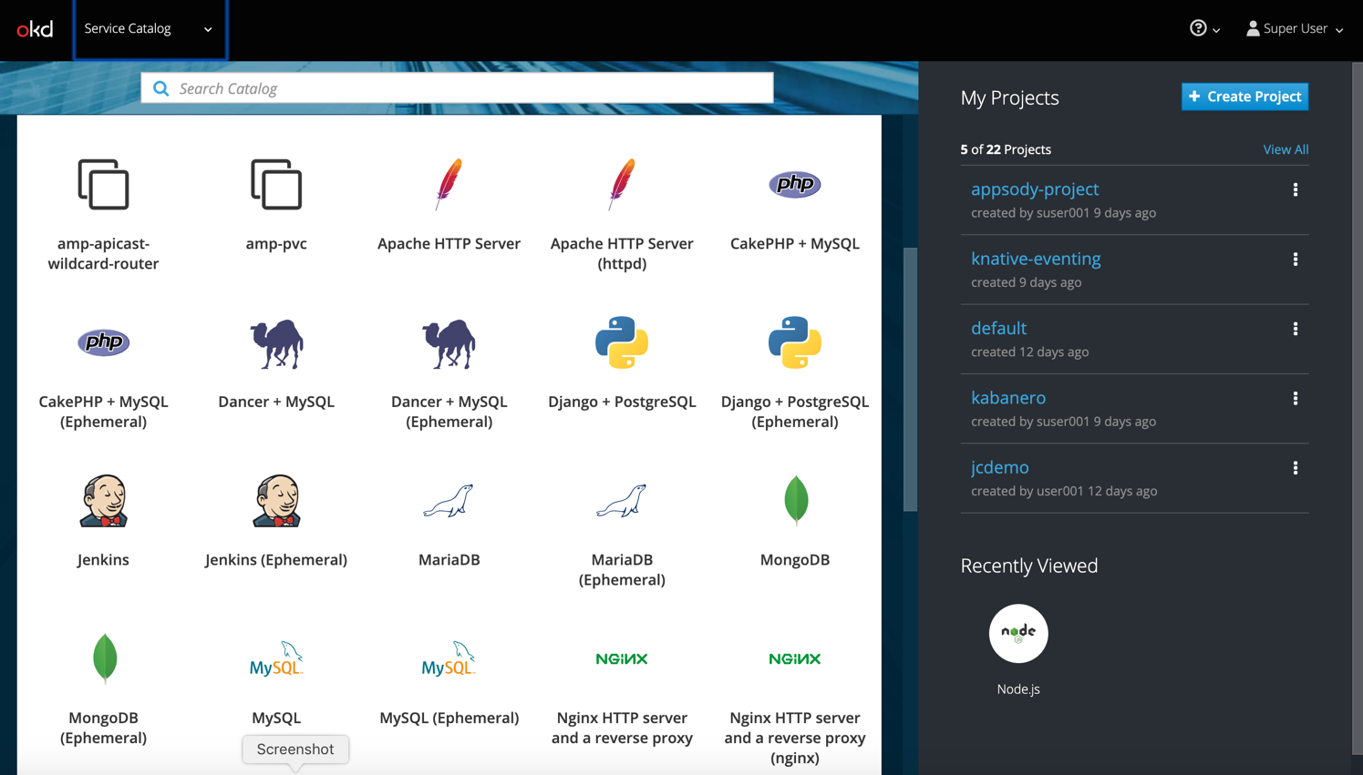
Web Console
Application dashboard
Service Catalog

Slide 15

IBM Cloud Paks
A faster, more secure way to move your core business applications to any cloud
through enterprise-ready containerized software solutions
Complete yet simple Application, data and AI services, fully modular and easy to consume
IBM certified Full software stack support, and ongoing security, compliance and version compatibility
Run anywhere On-premises, on private and public clouds, and in pre-integrated systems
IBM containerized software
Packaged with Open Source components, pre-integrated with the common operational services, and secure by design
Container platform and operational services Logging, monitoring, security, identity access management

Slide 16
IBM Certified and production ready
 | Containers Alone Client creates containers or receives software as standalone container(s) | IBM Cloud Paks Complete solutions certified for enterprise use cases
Runs anywhere | Yes | Yes
Vulnerability scanned | Yes | Yes
Red Hat container certification | Depends on product | Yes
Complete solution w/ container platform | No | Yes
Flexible & modular: Pay for what you use | No | Yes
IBM certified/orchestrated for production (Built for Kubernetes by experts; certified against 250+ criteria) | No | Yes
Multicloud validation | No | Yes
Integrated deployment experience | No | Yes
Full stack support by IBM (Base OS, software, and container platform) | No | Yes
License metering integration | No | Yes
Scalable and resilient | No | Yes
Encrypted secrets / limited privileges | Do it yourself | Yes
Management and operations | Build your own | Yes
Lifecycle Management | Manage it yourself | Yes
Cloud Paks
Speed to market
Containerized
software alone
Enterprise security

Slide 17


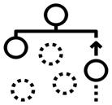

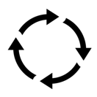













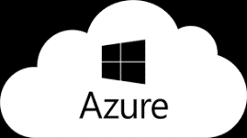



Organized by Capability
Cloud Pak for Applications
Cloud Pak for
Data
Cloud Pak for Integration
Cloud Pak for
Automation
Cloud Pak for
Multicloud Management
Developer & DevOps Tools
Modernization
Toolkit
Organize
Analyze
API Lifecycle
Messaging
and Events
Content
Operational
Intelligence
Multicluster
App and Infrastructure
Frameworks and Runtimes
Collect
App and Data Integration
Workflow and Decisions
Security and Compliance Management
Container platform and operational services
Container platform and operational services
Container platform and operational services
Container platform and operational services
Container platform and operational services
IBM Cloud
Edge
Private
Systems

